Slide 1
Measures of Dispersion
Measures of central tendency alone cannot completely characterize a set of data. Two very different data sets may have similar measures of central tendency.
Measures of dispersion are used to describe the spread, or variability, of a distribution
Common measures of dispersion: range, variance, and standard deviation

Slide 2



Range
Range: The difference in value between the highest-valued (H) and the lowest-valued (L) pieces of data:
Other measures of dispersion are based on the following quantity
Deviation from the Mean: A deviation from the mean, ,
is the difference between the value of x and the mean

Slide 3
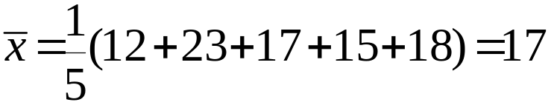



Example
Example: Consider the sample {12, 23, 17, 15, 18}.
Find 1) the range and 2) each deviation from the mean.
Solutions:
1)
2)
Data Deviation from Mean
_________________________
12
23
17
15
18
-5
6
0
-2
1

Slide 4
Mean Absolute Deviation
Note: (Always!)
∑
(
x
−
x
)
=
0
Mean Absolute Deviation: The mean of the absolute values of the deviations from the mean:
1
∑
Mean
absolute
deviation
=
|
x
−
x
|
n
For the previous example:
1
∑
1
14
|
x
−
x
|
=
(
5
+
6
+
0
+
2
+
1
)
=
=
2
.
8
n
5
5

Slide 5
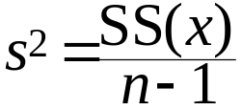

Sample Variance & Standard Deviation
Sample Variance: The sample variance, s², is the mean of the squared deviations, calculated using n − 1 as the divisor:
1
∑
s
2
=
(
x
−
x
)
2
where n is the sample size
n
−
1
Note: The numerator for the sample variance is called the sum of squares for x, denoted SS(x):
∑
∑
1
(
∑
)
where
SS
(
x
)
=
(
x
−
x
)
2
=
x
2
−
x
2
n
Standard Deviation: The standard deviation of a sample, s, is the positive square root of the variance:

Slide 6
Example
Example: Find the 1) variance and 2) standard deviation for the data {5, 7, 1, 3, 8}:
Solutions:
First:
x
=
1
(
5
+
7
+
1
+
3
+
8
)
=
4
.
8
5
x
x
−
x
(
x
−
x
)
2
5
0.2
0.04
7
2.2
4.84
1
-3.8
14.44
3
-1.8
3.24
8
3.2
10.24
Sum:
24
0
32.08
1)
1
s
2
=
(
32
.
8
)
=
8
.
2
2)
s
=
8
.
2
=
2
.
86
4

Slide 7
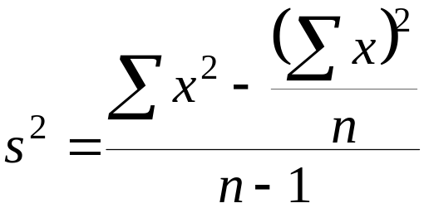
Notes
The shortcut formula for the sample variance:
The unit of measure for the standard deviation is the same as the unit of measure for the data

Slide 8
Mean & Standard
Deviation of Frequency Distribution
If the data is given in the form of a frequency distribution, we need to make a few changes to the formulas for the mean, variance, and standard deviation
Complete the extension table in order to find these summary statistics

Slide 9
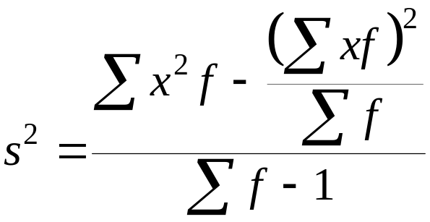
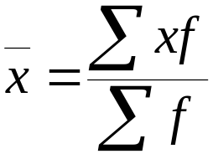
To Calculate
In order to calculate the mean, variance, and standard deviation for data:
1. In an ungrouped frequency distribution, use the frequency of occurrence, f, of each observation
2. In a grouped frequency distribution, we use the frequency of occurrence associated with each class midpoint:

Slide 10




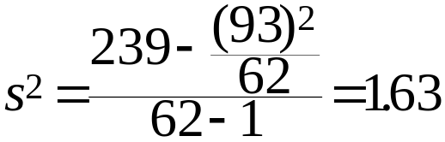


Example
Example: A survey of students in the first grade at a local school asked for the number of brothers and/or sisters for each child. The results are summarized in the table below. Find 1) the mean, 2) the variance, and
3) the standard deviation:
Solutions:
First:
0
15
0
0
1
17
17
17
2
23
46
92
4
5
20
80
5
2
10
50
Sum:
62
93
239
1)
2)
3)

Slide 11
Measures of Position
Measures of position are used to describe the relative location of an observation
Quartiles and percentiles are two of the most popular measures of position
An additional measure of central tendency, the midquartile, is defined using quartiles
Quartiles are part of the 5-number summary

Slide 12
Measures of Relative Position
A measure of relative position tells where data values fall within the ordered set.
The measures of relative position we will calculate are the quartiles, percentiles, and standard score.

Slide 13





Quartiles
Quartiles: Values of the variable that divide the ranked data into quarters; each set of data has three quartiles
1. The first quartile, Q₁, is a number such that at most 25% of the data are smaller in value than Q₁ and at most 75% are larger
2. The second quartile, Q₂, is the median
3. The third quartile, Q₃, is a number such that at most 75% of the data are smaller in value than Q₃ and at most 25% are larger
Ranked data, increasing order

Slide 14
Quartiles:
Quartiles divide a data set into four equal parts.
To find the quartiles of a data set:
  Find the median, Q₂.
  Use the median to divide the data into two groups.
    For an odd number of data points, include the median in both the upper and lower halves.
    For an even number of data points, do not include the median in either half.
  The median of the lower group is Q₁ and the median of the upper group is Q₃.

Slide 15
Find the quartiles for the following data set:
2 3 5 7 8 9 10 12 15
Solution:
First find the median.
Q₂ = 8.
Now, find the median of the first half of data.
Q₁ = 5.
Finally, find the median of the second half of data.
Q₃ = 10.

Slide 16
Find the quartiles for the following data set:
10 12 14 15 14 16 17 18 10 19 17 17
Solution:
First order the data.
10 10 12 14 14 15 16 17 17 17 18 19
Q₂ = 15.5
Q₁ = 13
Q₃ = 17

Slide 17
Find the quartiles for the following data set:
11 11 14 15 16
16 17 19 22 25
26 27 31 34 36
Solution:
First order the data.
11 11 14 15 16 16 17 19 22 25 26 27 31 34 36
Q₂ = 19
Q₁ = 15.5
Q₃ = 26.5

Slide 18
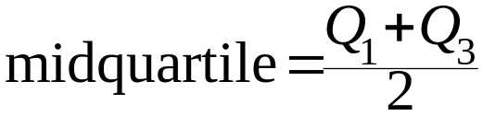
Midquartile
Midquartile: The numerical value midway between the first and third quartile:
Example: Find the midquartile for the 20 pH values in the previous example:
Q
+
Q
6
+
6
.
95
12
.
95
midquartil
e
=
1
3
=
=
=
6
.
475
2
2
2
Note: The mean, median, midrange, and midquartile are all measures of central tendency. They are not necessarily equal. Can you think of an example when they would be the same value?

Slide 19

5-Number Summary
5-Number Summary: The 5-number summary is composed of:
1. L, the smallest value in the data set
2. Q₁, the first quartile (also P₂₅)
3. , the median (also P₅₀ and 2nd quartile)
4. Q₃, the third quartile (also P₇₅)
5. H, the largest value in the data set
Notes:
The 5-number summary indicates how much the data is spread out in each quarter
The interquartile range is the difference between the first and third quartiles. It is the range of the middle 50% of the data

Slide 20
Box-and-Whisker Display
Box-and-Whisker Display: A graphic representation of the
5-number summary:
The five numerical values (smallest, first quartile, median, third quartile, and largest) are located on a scale, either vertical or horizontal
The box is used to depict the middle half of the data that lies between the two quartiles
The whiskers are line segments used to depict the other half of the data
One line segment represents the quarter of the data that is smaller in value than the first quartile
The second line segment represents the quarter of the data that is larger in value that the third quartile

Slide 21
Box Plot:
A box plot is a graphical representation of a five-number summary.
Steps for creating a box plot:
Begin with a horizontal (or vertical) number line.
Draw a small line segment above (or next to) the number line to represent each of the numbers in the five-number summary.
Connect the line segment that represents the first quartile to the line segment representing the third quartile, forming a box with the median’s line segment in the middle.
Connect the “box” to the line segments representing the minimum and maximum values to form the “whiskers”.

Slide 22
Draw a box plot for the given sample data:
8 9 10 2 5 3 7 12 15
Solution:
First order the data.
2 3 5 7 8 9 10 12 15
Minimum
Q₁
Q₂
Q₃
Maximum
0 1 2 3 4 5 6 7 8 9 10 11 12 13 14 15 16 17 18 19 20

Slide 23
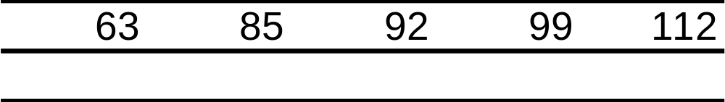
Example
Example: A random sample of students in a sixth grade class was selected. Their weights are given in the table below. Find the 5-number summary for this data and construct a boxplot:
63 64 76 76 81 83 85 86 88 89 90 91 92 93 93 93 94 97 99 99 99 101 108 109 112
Solution:

Slide 24
Boxplot for Weight Data
Weights from Sixth Grade Class
6
0
7
0
8
0
9
0
1
0
0
1
1
0
Weight

Slide 25

Percentiles
Percentiles: Values of the variable that divide a set of ranked data into 100 equal subsets; each set of data has 99 percentiles. The kth percentile, P_{k}, is a value such that at most k% of the data is smaller in value than P_{k} and at most (100 − k)% of the data is larger.
Notes:
The 1st quartile and the 25th percentile are the same: Q₁ = P₂₅
The median, the 2nd quartile, and the 50th percentile are
all the same:
~
=
=
x
Q
P
2
50

Slide 26
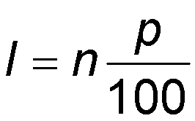
Percentiles:
Percentiles divide the data into 100 equal parts.
At the n^{th} percentile, n% of the data lies at or below a given value.
Formula:
      where l = location of the data value
      p = percentile as a whole number
      n = sample size

Slide 27
Percentiles (continued):
When using this formula to find the location of the percentile’s value in the data set you must make sure to follow these two rules:
  If the formula results in a decimal value for l, the location is the next largest integer.
  If the formula results in a whole number, the percentile’s value is the average of the value in that location and the one in the next largest location.
When calculating the percentile, always round up to the next integer.

Slide 28
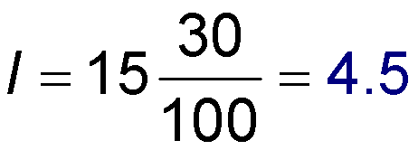
What data value lies at the 30th percentile?
11 11 14 15 16
16 17 19 22 25
26 27 31 34 36
Solution:
First order the data.
The sample size is n = 15.
The 30th percentile means p = 30.
Since l = 4.5 we will round up to 5 and the value in the 5th position is 16.
11 11 14 15 16 16 17 19 22 25 26 27 31 34 36

Slide 29
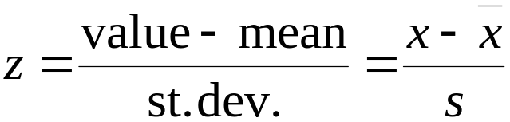
z-Score
z-Score: The position a particular value of x has relative to the mean, measured in standard deviations. The z-score is found by the formula:
Notes:
Typically, the calculated value of z is rounded to the nearest hundredth
The z-score measures the number of standard deviations above/below, or away from, the mean
z-scores typically range from -3.00 to +3.00
z-scores may be used to make comparisons of raw scores

Slide 30
Standard Scores:
Standard scores, or z-scores, tell a data value’s position in relation to the mean of the set.
Formula:

Slide 31



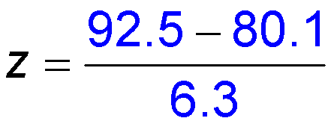

Find the Standard Score:
Suppose that the mean on test 1 was 80.1 with a standard deviation of 6.3 points. If a student made a 92.5, what is the student’s standard score?
Solution:
When calculating the standard score, always round to two decimal places.

Slide 32
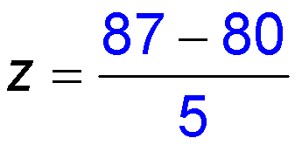
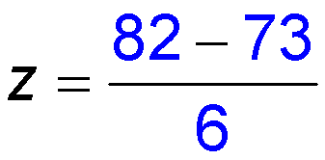


Who did better on their exam with respect to their class?
Student A scored an 87 Student B scored an 82
Solution:
Since Student B’s score was more standard deviations above the mean, Student B did better with respect to their class.

Slide 33
Why z-Scores?
Transforming raw scores to z-scores facilitates making comparisons, especially when using different scales.
A z-score provides information about the relative position of a score in relation to other scores in a sample or population.
  A raw score provides no information regarding the relative standing of the score relative to other scores.
  A z-score tells one how many standard deviations the score is from the mean. It also provides the approximate percentile rank of the score relative to other scores. For example, a z-score of 1 is 1 standard deviation above the mean and equals the 84.1 percentile rank (50% of occurrences fall below the mean and 34.1% of the occurrences fall between 0 and 1; 50% + 34.1% = 84.1%).

Slide 34
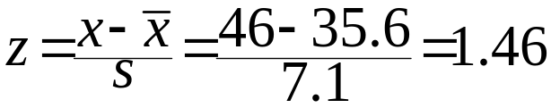
Example
Example: A certain data set has mean 35.6 and standard deviation 7.1. Find the z-scores for 46 and 33:
Solutions:
46 is 1.46 standard deviations above the mean
x
−
x
33
−
35
.
6
z
=
=
=
0
.
37
s
7
.
1
33 is 0.37 standard deviations below the mean.

Slide 35
Interpretation of z-Scores
If z = 0 an observation is at the mean.
If z > 0 the observation is above the mean in value, e.g. if z = 2.00 the observation is 2 SDs above the mean.
If z < 0 the observation is below the mean in value, e.g. if z = -1.00 the observation is 1 SD below the mean.

Slide 36
The Empirical Rule (z-scores)
99.7% of data are within 3 standard deviations of the mean
95% within
2 standard deviations
68% within
1 standard deviation
34%
34%
2.4%
2.4%
0.1%
0.1%
13.5%
13.5%
-3.00
-2.00
-1.00
0
1.00
2.00
3.00
z-score

Slide 37
The Empirical Rule (z-scores)
Therefore for normally distributed data:
68% of observations have z-scores between
-1.00 and 1.00
95% of observations have z-scores between
-2.00 and 2.00
99.7 of observations have z-scores between
-3.00 and 3.00

Slide 38
Outliers based on z-scores
When we consider the empirical rule an observation with a
z-score < -2.00 or z-score > 2.00
might be characterized as a mild outlier.
Any observation with a
z-score < - 3.00 or z-score > 3.00
might be characterized as an extreme outlier.

Slide 39
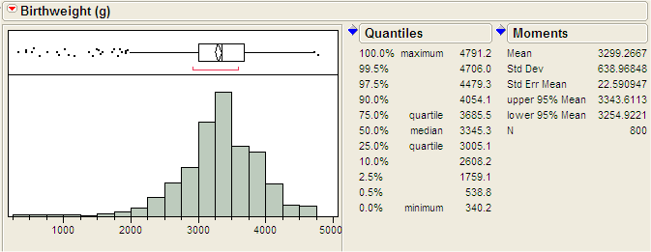
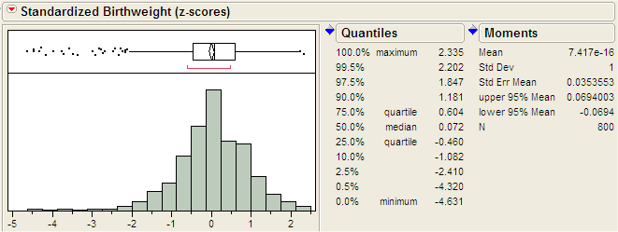
Standardized Variables
We can convert each observed value of a numeric variable to its associated z-score. This process is called standardization and the resulting variable is called the standardized variable.
Note: When standardized the mean is 0 and standard deviation is 1

Slide 40
Interpreting & Understanding
Standard Deviation
Standard deviation is a measure of variability, or spread
Two rules for describing data rely on the standard deviation:
  Empirical rule: applies to a variable that is normally distributed
  Chebyshev’s theorem: applies to any distribution

Slide 41
Empirical Rule
Empirical Rule: If a variable is normally distributed, then:
1. Approximately 68% of the observations lie within 1 standard deviation of the mean
2. Approximately 95% of the observations lie within 2 standard deviations of the mean
3. Approximately 99.7% of the observations lie within 3 standard deviations of the mean
Notes:
The empirical rule is more informative than Chebyshev’s theorem since we know more about the distribution (normally distributed)
Also applies to populations
Can be used to determine if a distribution is normally distributed

Slide 42
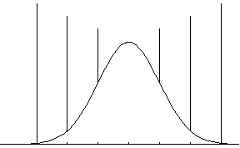







Illustration of the Empirical Rule
99.7%
95%
68%

Slide 43
Example
Example: A random sample of plum tomatoes was selected from a local grocery store and their weights recorded. The mean weight was 6.5 ounces with a standard deviation of 0.4 ounces. If the weights are normally distributed:
1) What percentage of weights fall between 5.7 and 7.3?
2) What percentage of weights fall above 7.7?
Solutions:
1)
(
x
−
2
s
,
x
+
2
s
)
=
(
6
.
5
−
2
(0.
4
),
6
.
5
+
2
(0.
4
))
=
(
5
.
7
,
7
.
3
)
Approximat
ely 95% of
the weigh
ts fall be
tween 5.7
and 7.3
2)
(
x
−
3
s
,
x
+
3
s
)
=
(
6
.
5
−
3
(0.
4
),
6
.
5
+
3
(0.
4
))
=
(
5
.
3
,
7
.
7
)
Approximat
ely 99.7%
of the wei
ghts fall
between 5.
3 and 7.7
Approximat
ely 0.3% of
the weigh
ts fall out
side (5.3,
7.7)
Approximat
ely (0.3
/
2)
=0.15% of t
he weights
fall abov
e 7.7

Slide 44
A Note about the Empirical Rule
Note: The empirical rule may be used to determine whether or not a set of data is approximately normally distributed
1. Find the mean and standard deviation for the data
2. Compute the actual proportion of data within 1, 2, and 3 standard deviations from the mean
3. Compare these actual proportions with those given by the empirical rule
4. If the proportions found are reasonably close to those of the empirical rule, then the data is approximately normally distributed

Slide 45
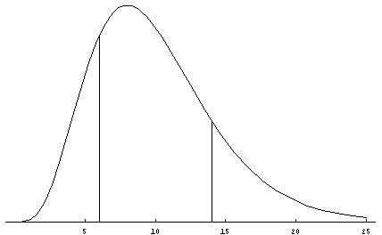
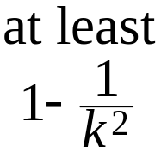


Chebyshev’s Theorem
Chebyshev’s Theorem: The proportion of any distribution that lies within k standard deviations of the mean is at least 1 − (1/k²), where k is any positive number larger than 1. This theorem applies to all distributions of data.
Illustration:

Slide 46
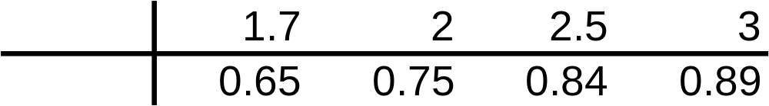


Important Reminders!
Chebyshev’s theorem is very conservative and holds for any distribution of data
Chebyshev’s theorem also applies to any population
The two most common values used to describe a distribution of data are k = 2, 3
The table below lists some values for k and 1 - (1/k²):

Slide 47
Example
Example: At the close of trading, a random sample of 35 technology stocks was selected. The mean selling price was 67.75 and the standard deviation was 12.3. Use Chebyshev’s theorem (with k = 2, 3) to describe the distribution.
Solutions:
Using k=2: At least 75% of the observations lie within 2 standard deviations of the mean:
Using k=3: At least 89% of the observations lie within 3 standard deviations of the mean:

